Slide 1
Lab 1: BASC
Varun Aggarwal

Slide 2
Summary
Total Iterations: 12
Pixel size = 0.00369 mm
Matrix Inversion Method: UTCholesky Inverse
Attached Files:
first_try.out
first_try.res
first_try.sigma

Slide 3
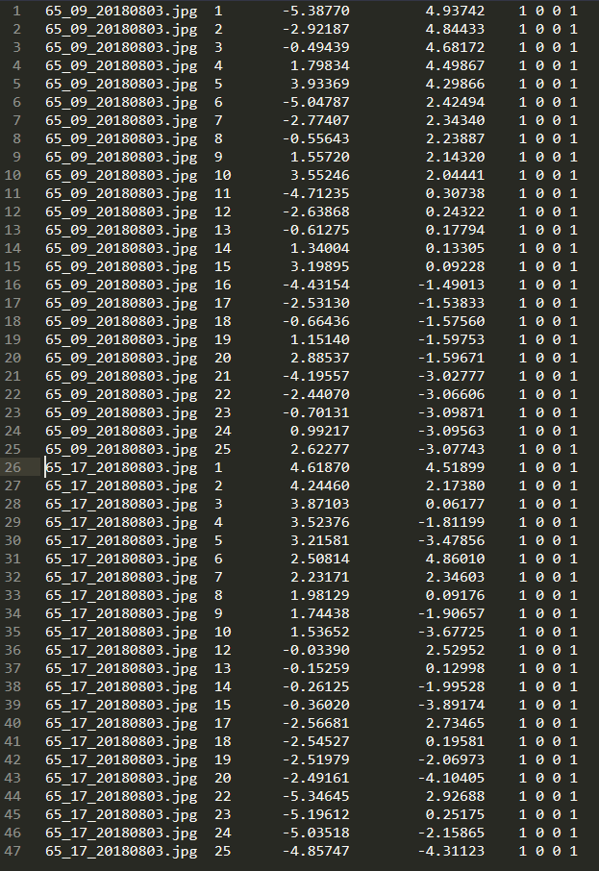
Measured image coordinates in mm as exported from POOM
Image 09
Image 17

Slide 4

The rationale and procedure behind preparing the initial approximations of the unknown EOPs
The initial approximation was broken down into two parts.
Part 1 was estimating the $x, y, z$for all the images
Part 2 was estimating the angles, $ω,φ,k$, for all the images

Slide 5
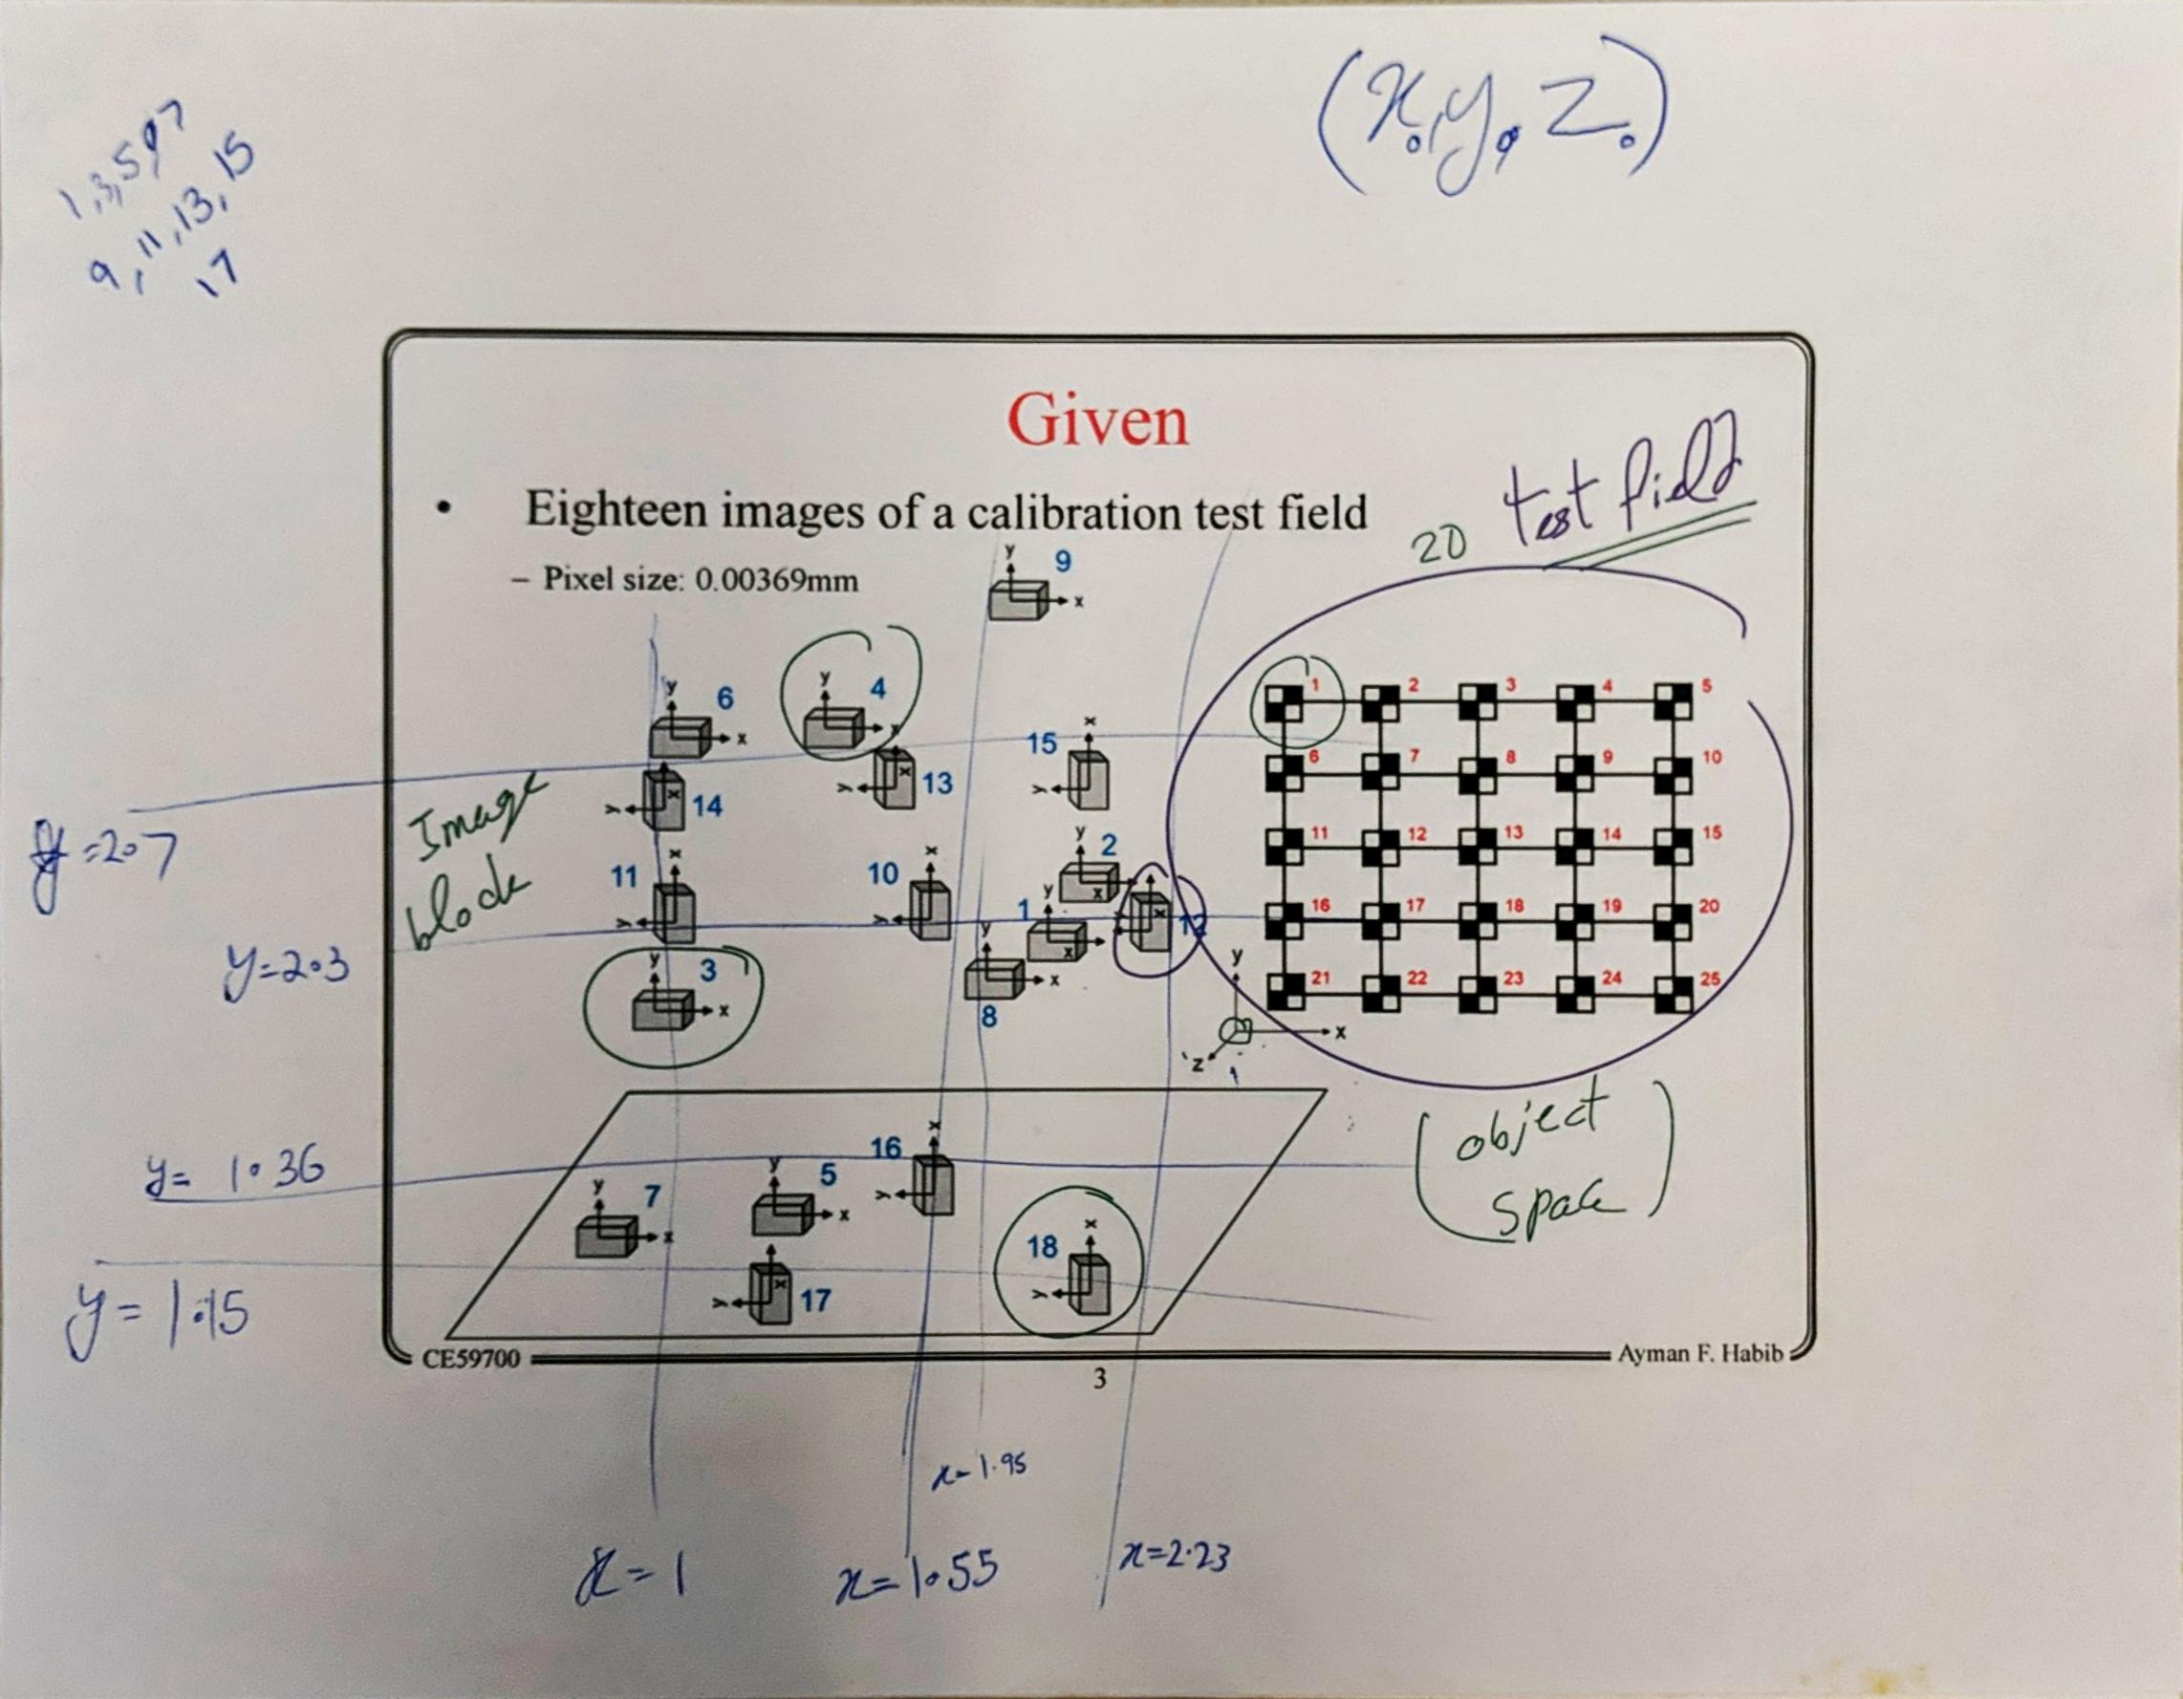
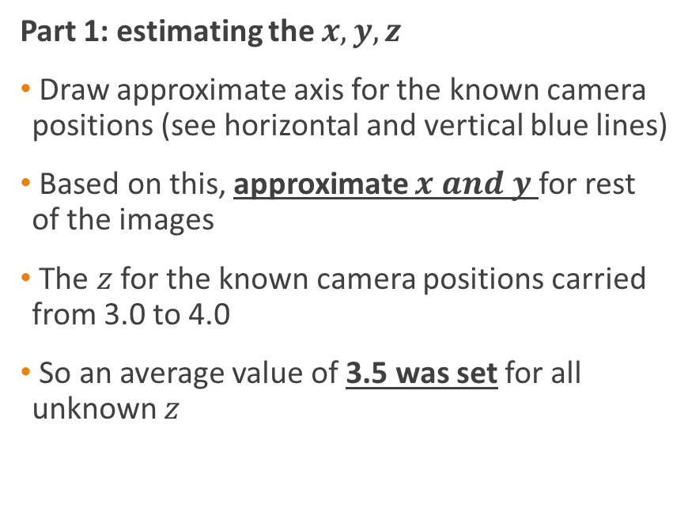
The rationale and procedure behind preparing the initial approximations of the unknown EOPs
Part 1: estimating the $x, y, z$
Draw approximate axis for the known camera positions (see horizontal and vertical blue lines)
Based on this, approximate $x and y$ for rest of the images
The $z$ for the known camera positions carried from 3.0 to 4.0
So an average value of 3.5 was set for all unknown $z$

Slide 6
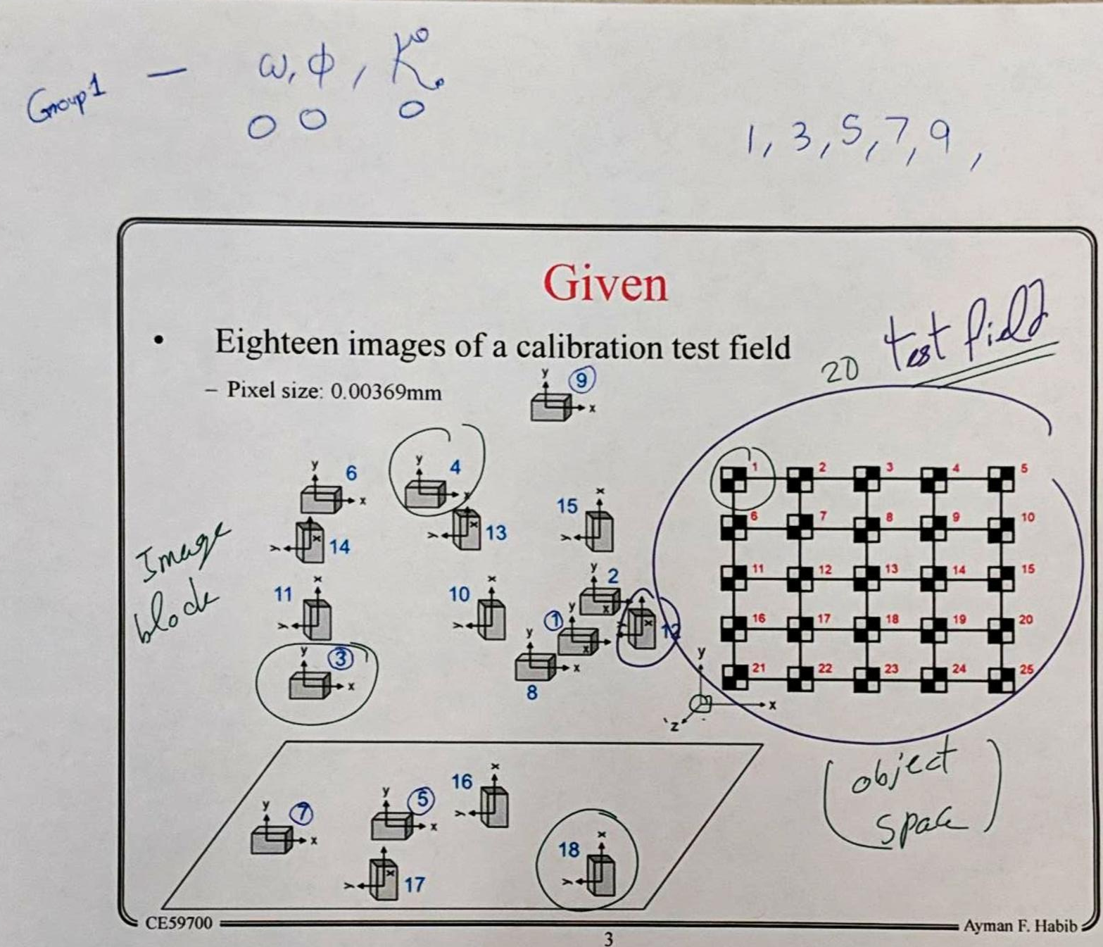
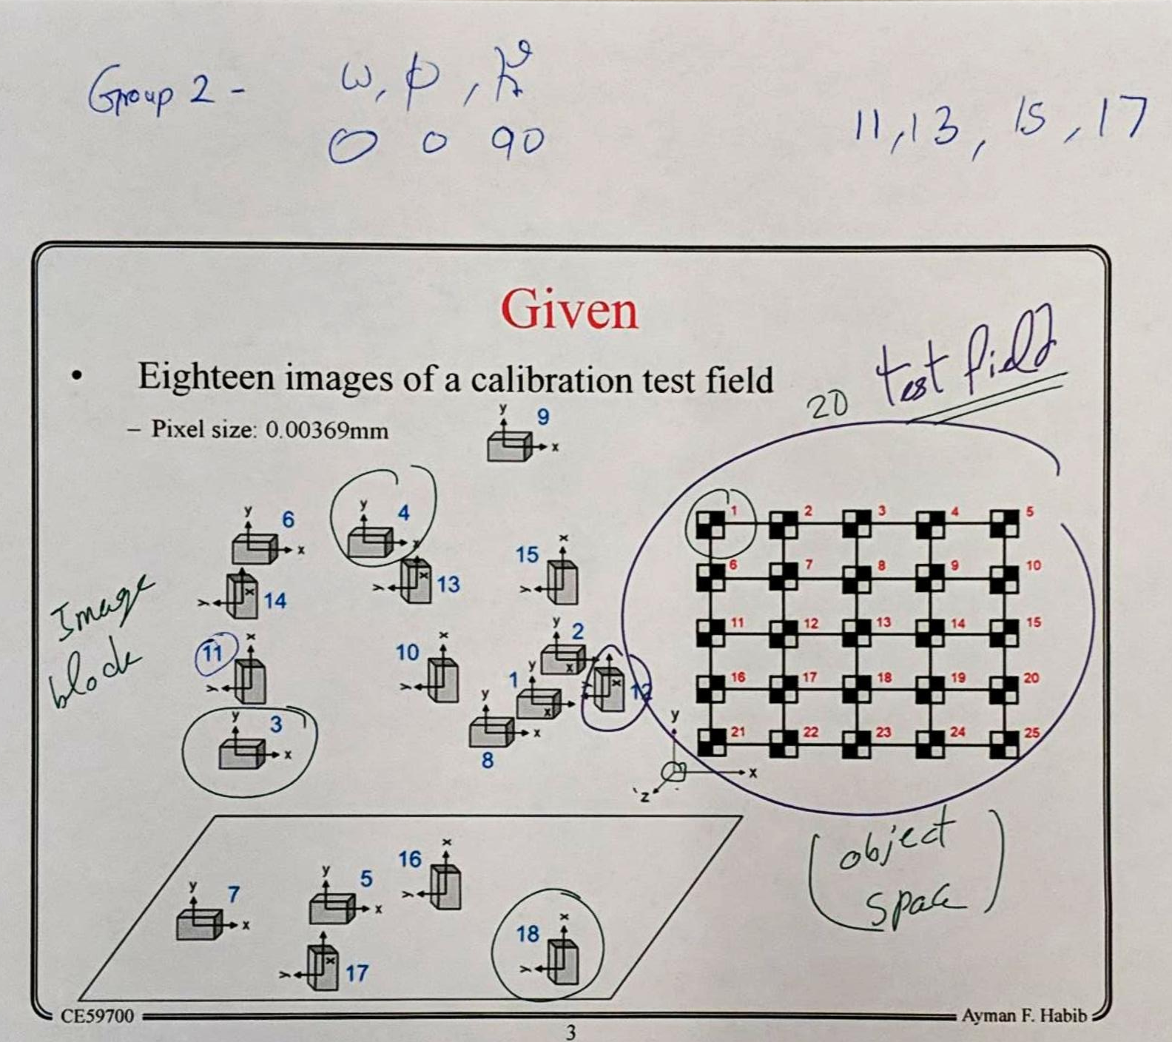
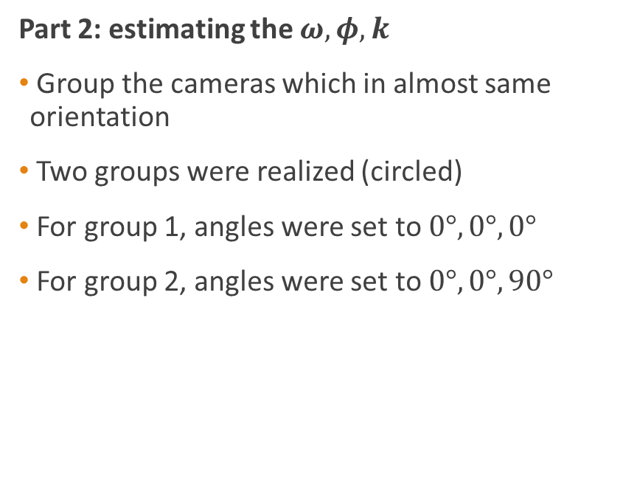
The rationale and procedure behind preparing the initial approximations of the unknown EOPs
Part 2: estimating the $ω,φ,k$
Group the cameras which in almost same orientation
Two groups were realized (circled)
For group 1, angles were set to $0°,0°,0°$
For group 2, angles were set to $0°,0°,90°$

Slide 7
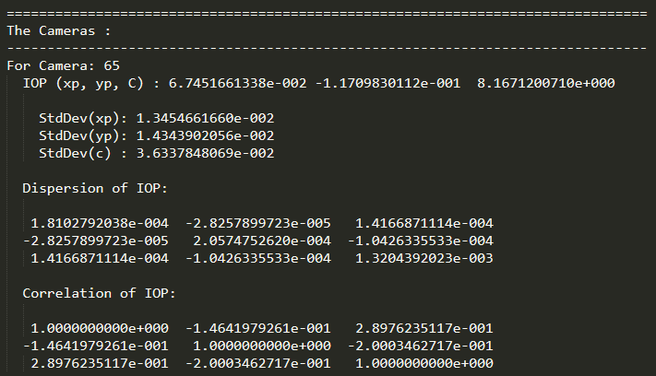
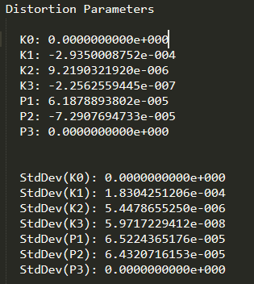
The final camera characteristics including the distortion parameters (found in the *.out file) IOPs
Internal Orientation Parameters (IOPs)
Distortion Parameters

Slide 8
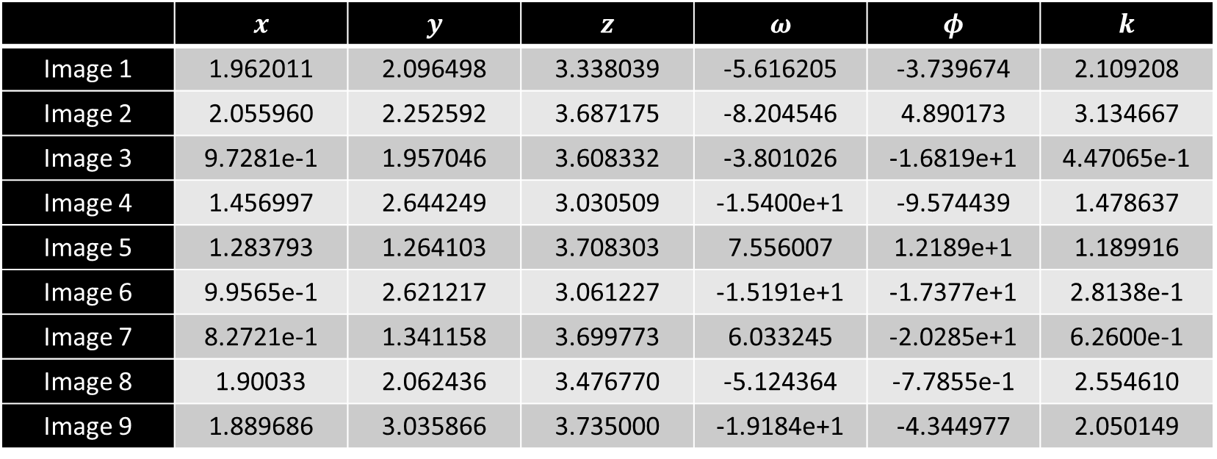
Tabulate your results for the EOPs of all images (found in the *.out file)
 | $$x$$ | $$y$$ | $$z$$ | $$ω$$ | $$φ$$ | $$k$$
Image 1 | 1.962011 | 2.096498 | 3.338039 | -5.616205 | -3.739674 | 2.109208
Image 2 | 2.055960 | 2.252592 | 3.687175 | -8.204546 | 4.890173 | 3.134667
Image 3 | 9.7281e-1 | 1.957046 | 3.608332 | -3.801026 | -1.6819e+1 | 4.47065e-1
Image 4 | 1.456997 | 2.644249 | 3.030509 | -1.5400e+1 | -9.574439 | 1.478637
Image 5 | 1.283793 | 1.264103 | 3.708303 | 7.556007 | 1.2189e+1 | 1.189916
Image 6 | 9.9565e-1 | 2.621217 | 3.061227 | -1.5191e+1 | -1.7377e+1 | 2.8138e-1
Image 7 | 8.2721e-1 | 1.341158 | 3.699773 | 6.033245 | -2.0285e+1 | 6.2600e-1
Image 8 | 1.90033 | 2.062436 | 3.476770 | -5.124364 | -7.7855e-1 | 2.554610
Image 9 | 1.889686 | 3.035866 | 3.735000 | -1.9184e+1 | -4.344977 | 2.050149

Slide 9
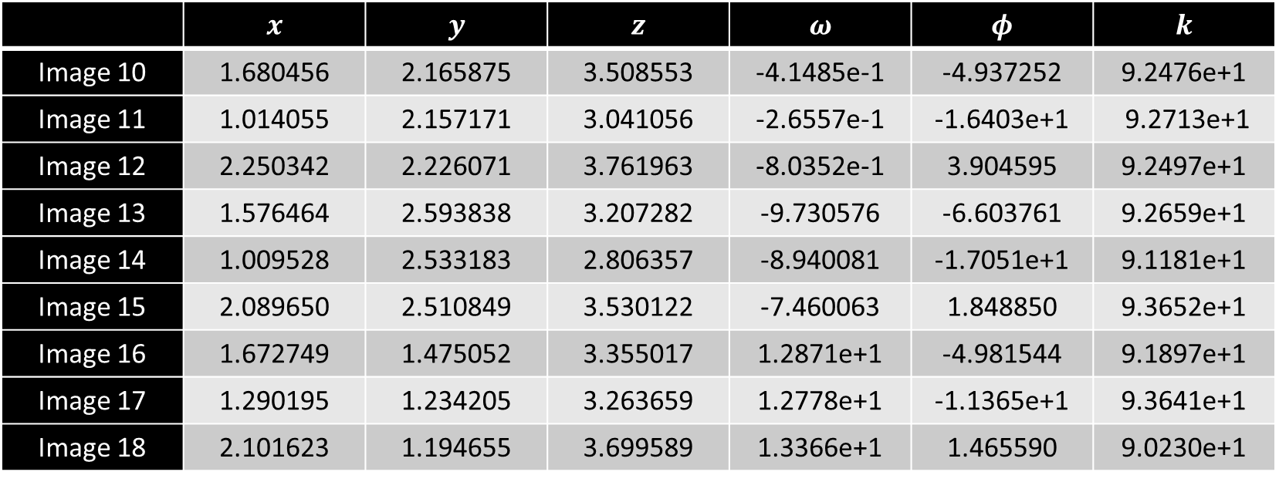
Tabulate your results for the EOPs of all images (found in the *.out file)
 | $$x$$ | $$y$$ | $$z$$ | $$ω$$ | $$φ$$ | $$k$$
Image 10 | 1.680456 | 2.165875 | 3.508553 | -4.1485e-1 | -4.937252 | 9.2476e+1
Image 11 | 1.014055 | 2.157171 | 3.041056 | -2.6557e-1 | -1.6403e+1 | 9.2713e+1
Image 12 | 2.250342 | 2.226071 | 3.761963 | -8.0352e-1 | 3.904595 | 9.2497e+1
Image 13 | 1.576464 | 2.593838 | 3.207282 | -9.730576 | -6.603761 | 9.2659e+1
Image 14 | 1.009528 | 2.533183 | 2.806357 | -8.940081 | -1.7051e+1 | 9.1181e+1
Image 15 | 2.089650 | 2.510849 | 3.530122 | -7.460063 | 1.848850 | 9.3652e+1
Image 16 | 1.672749 | 1.475052 | 3.355017 | 1.2871e+1 | -4.981544 | 9.1897e+1
Image 17 | 1.290195 | 1.234205 | 3.263659 | 1.2778e+1 | -1.1365e+1 | 9.3641e+1
Image 18 | 2.101623 | 1.194655 | 3.699589 | 1.3366e+1 | 1.465590 | 9.0230e+1

Slide 10
The final residuals of the image coordinates (found in the *.res output file)
Attached with the project

Slide 11
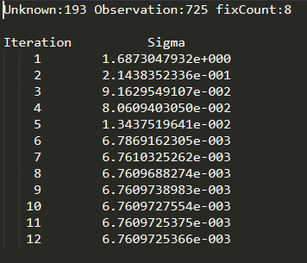
The calculated variance component for each iteration (found in the *.sigma file)

Slide 12
Explanation of any problems encountered
No major problems were encountered while using either POOM or BASC
While using POOM, forgot to save the file before opening another image.
A point of confusion during BASC was choosing the inversion method
After a little research, it was realized that it is just a matrix inversion algorithm not really related to the output of the results

Slide 13
END

